Slide 1



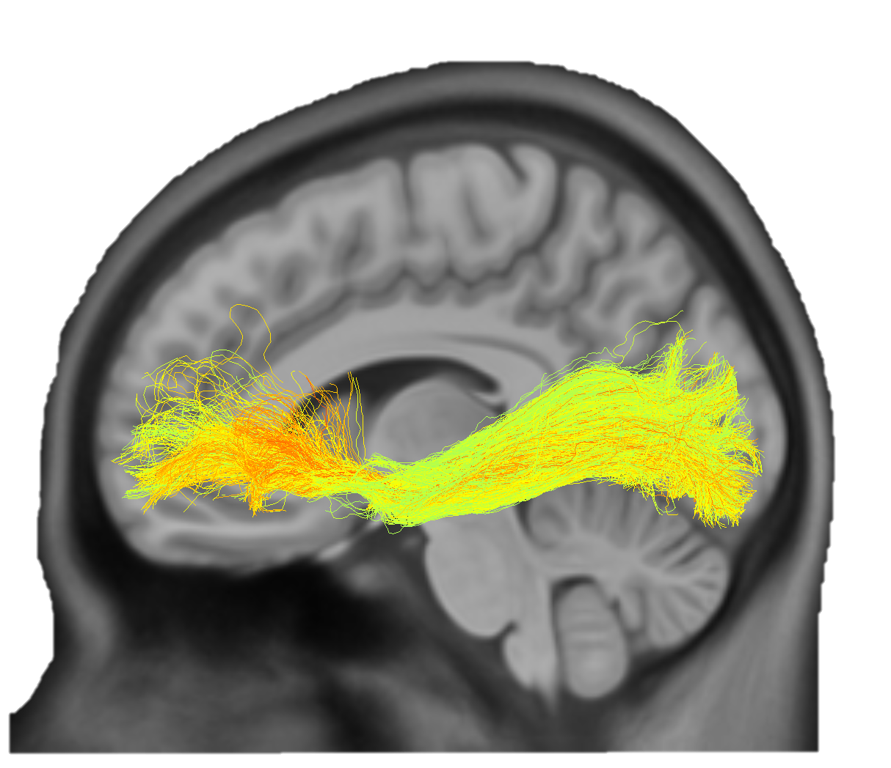
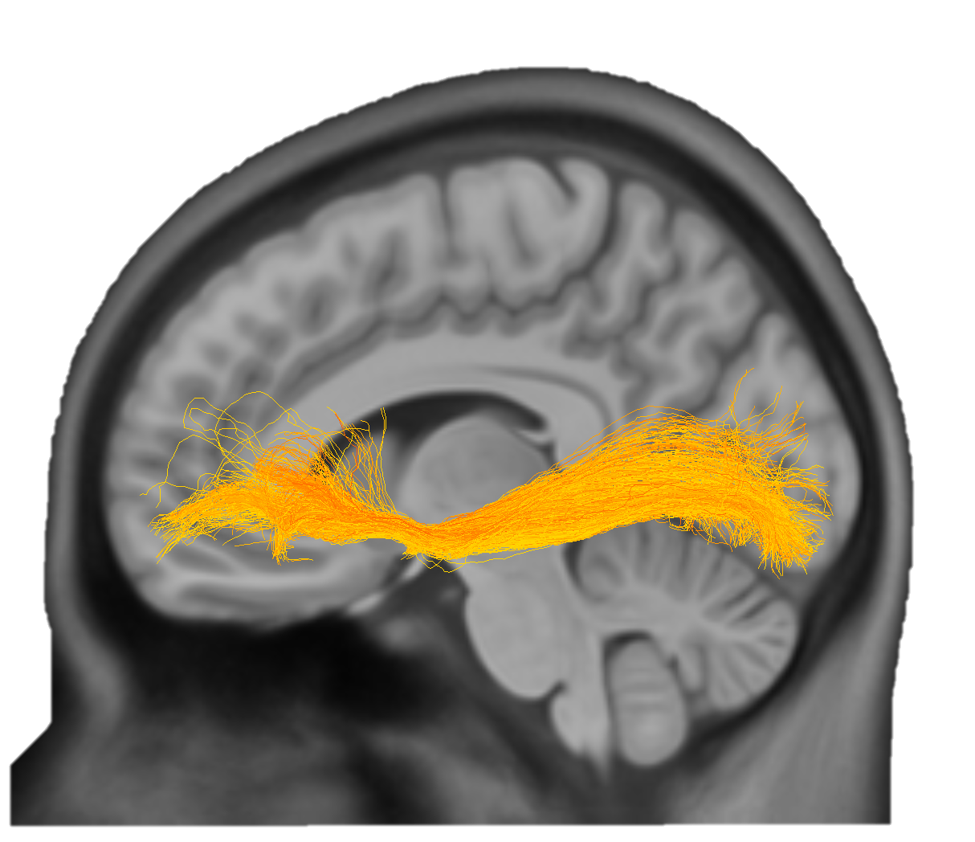
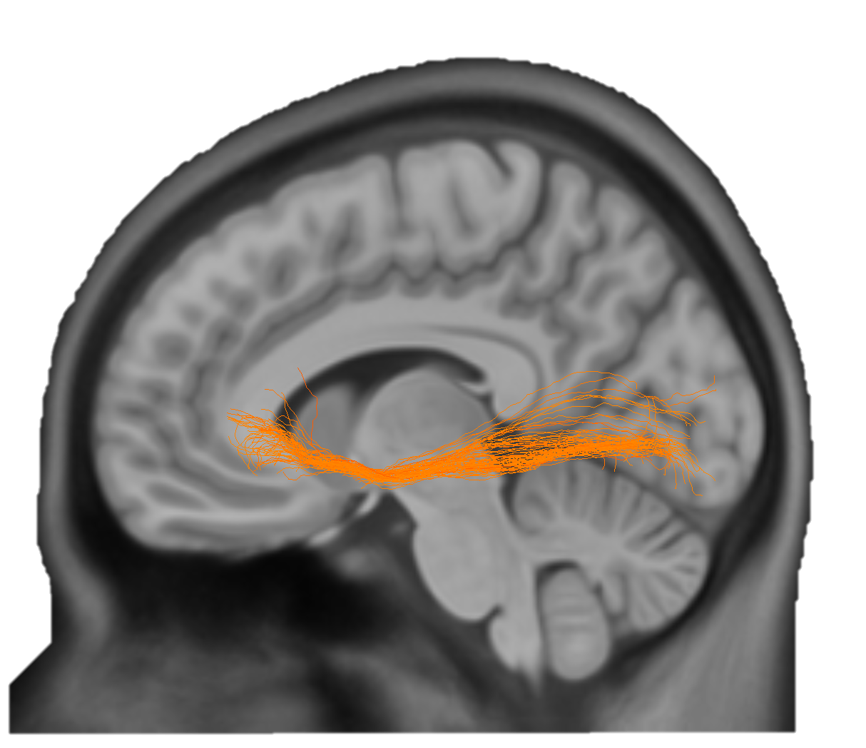
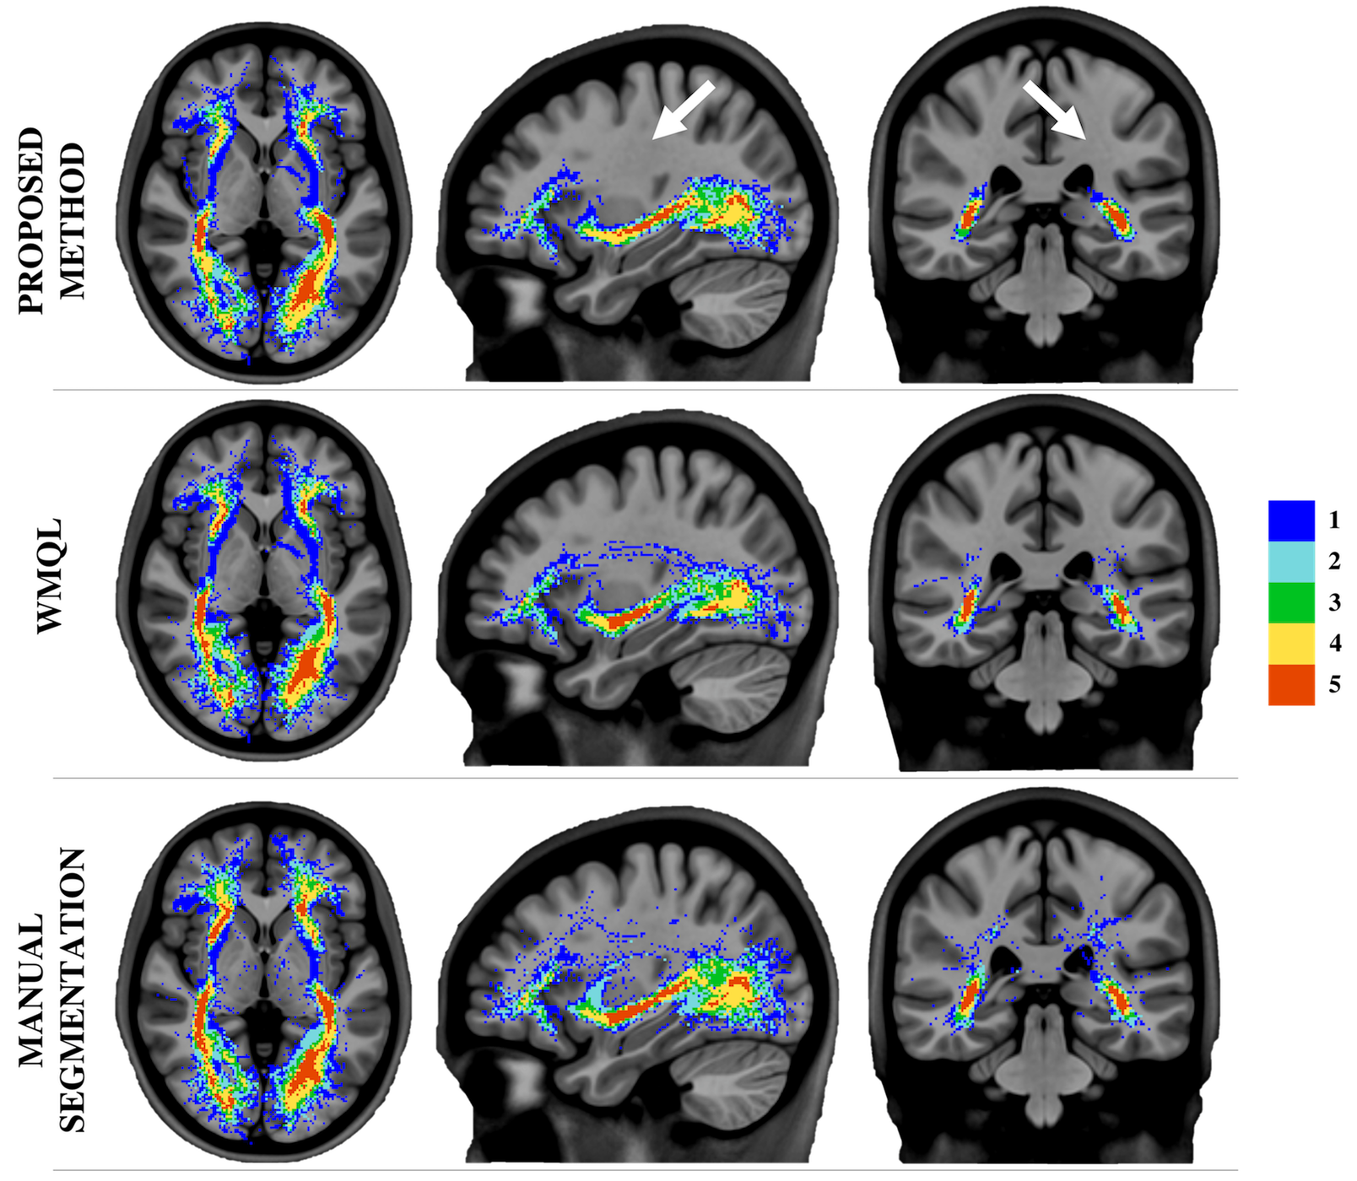
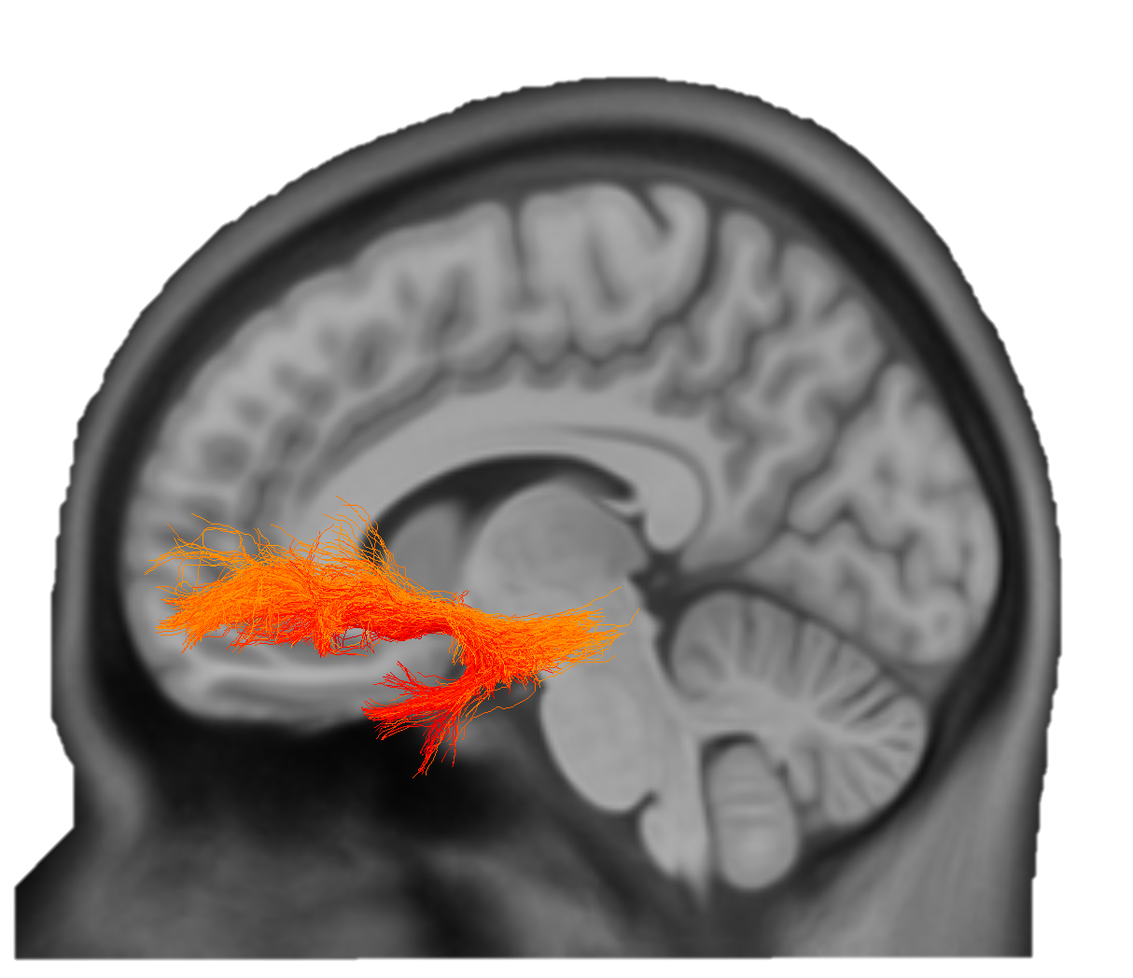
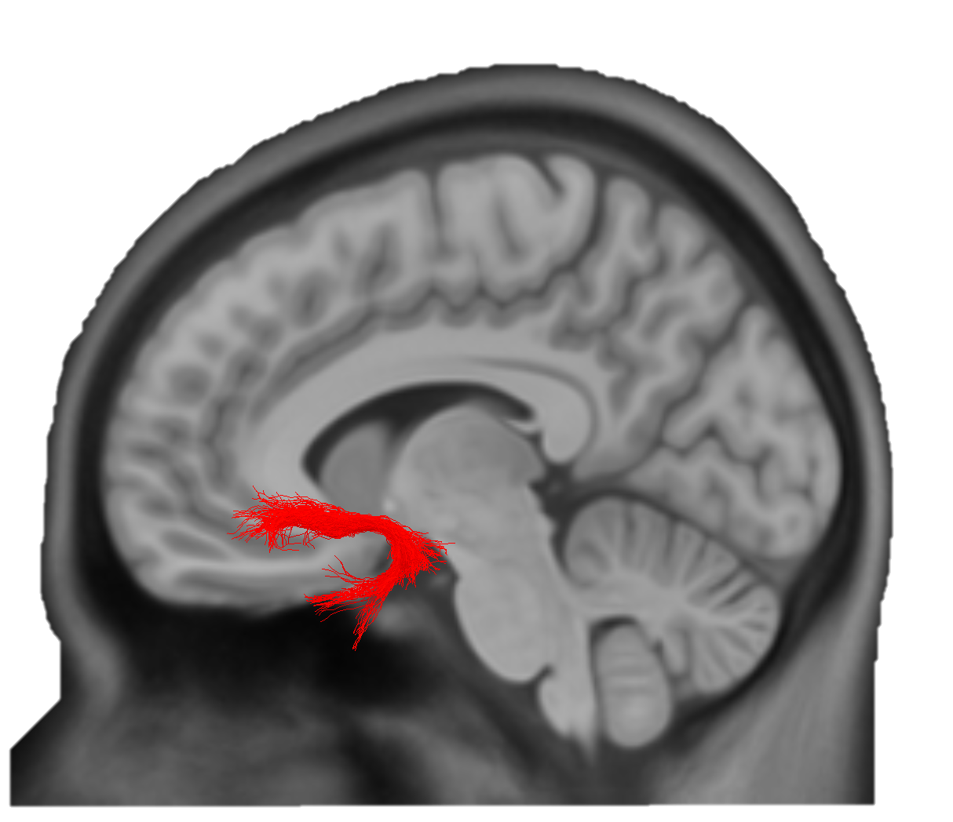

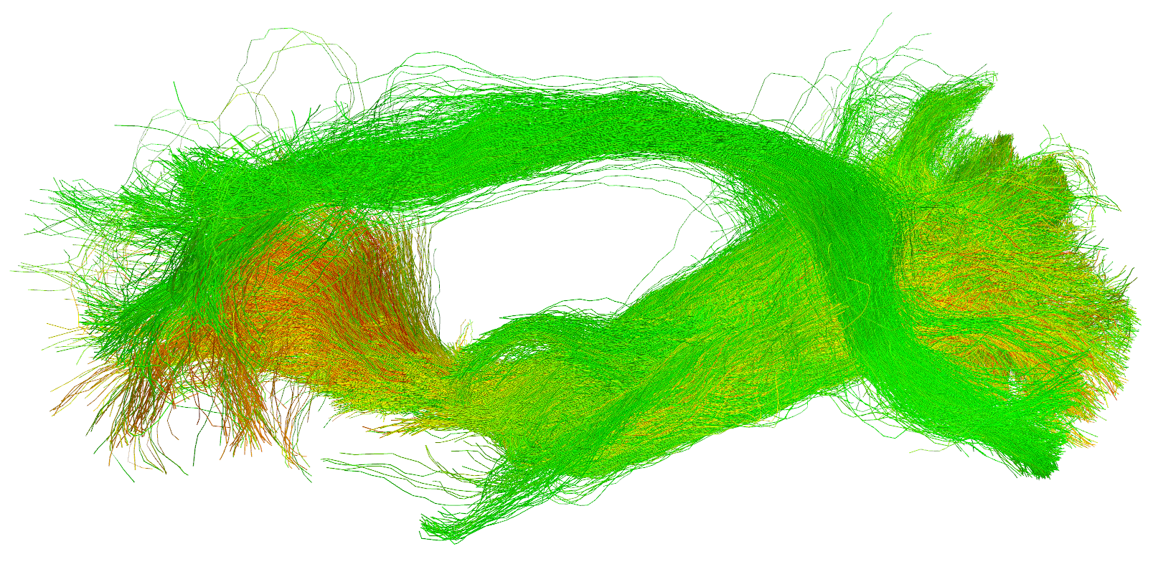
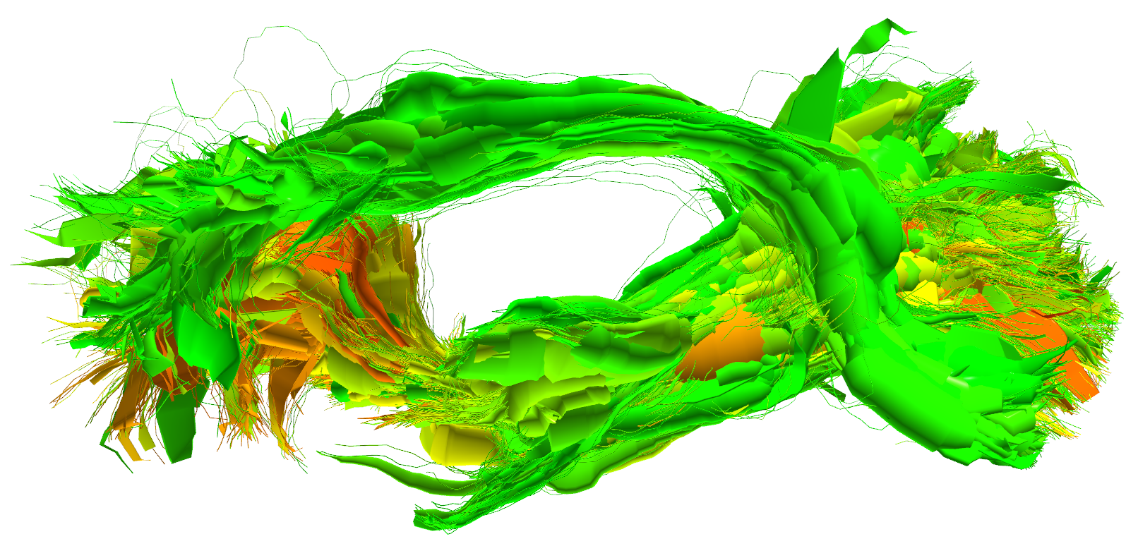
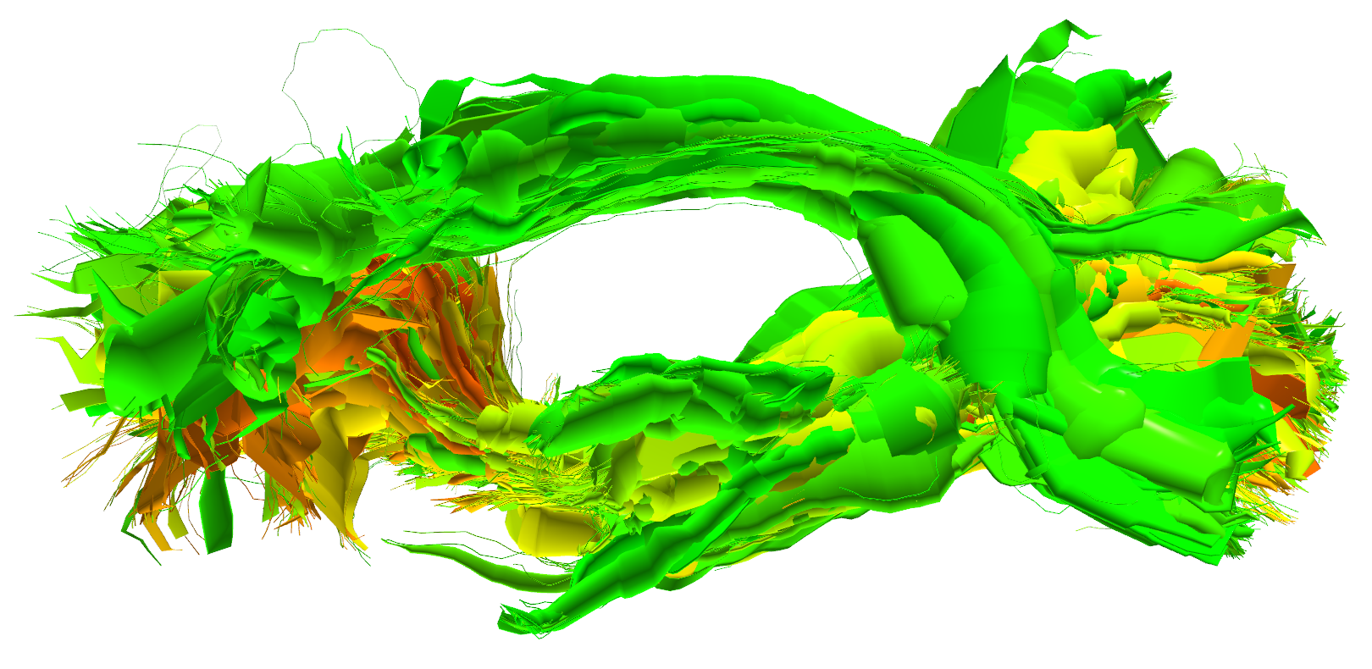
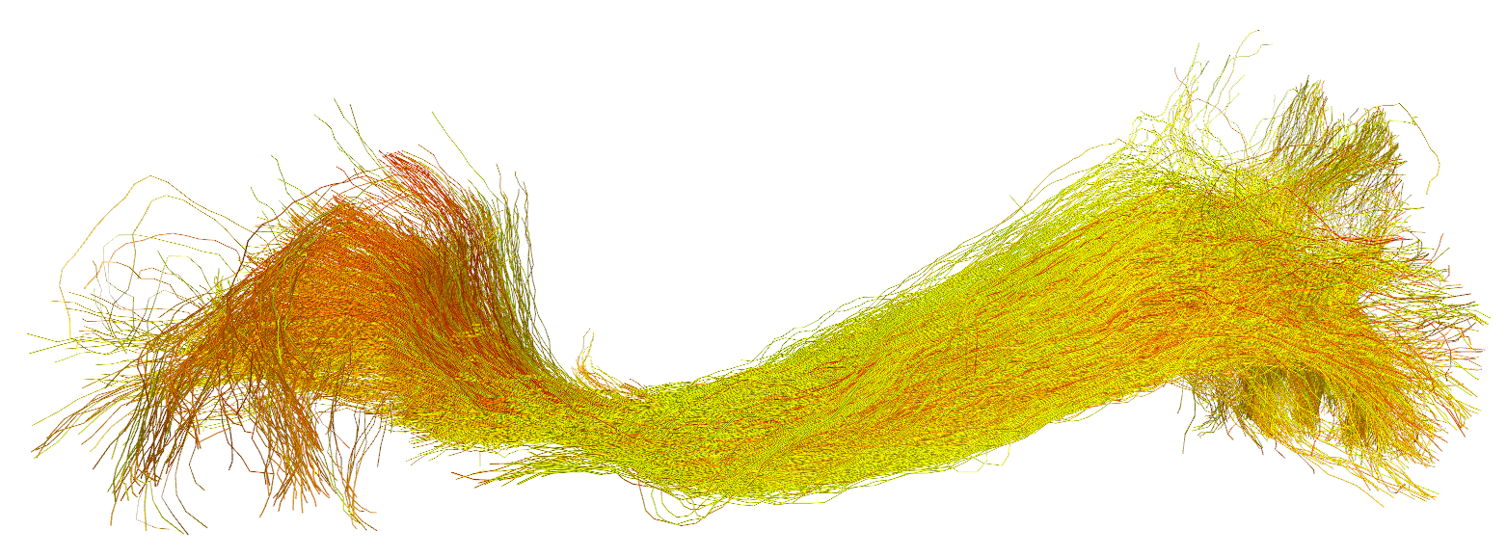
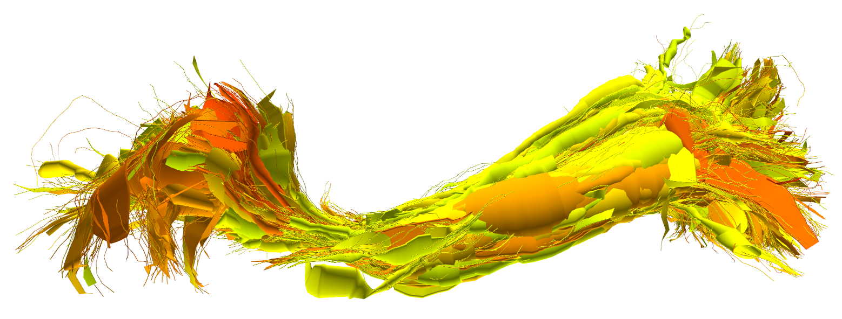
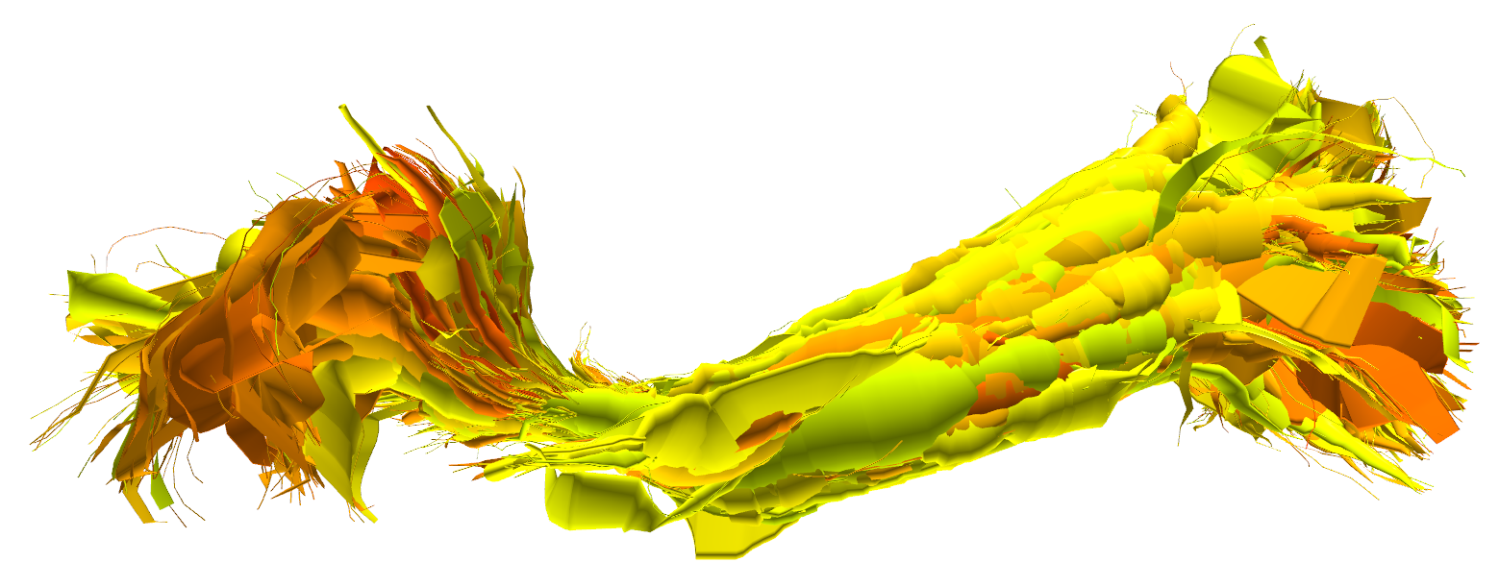
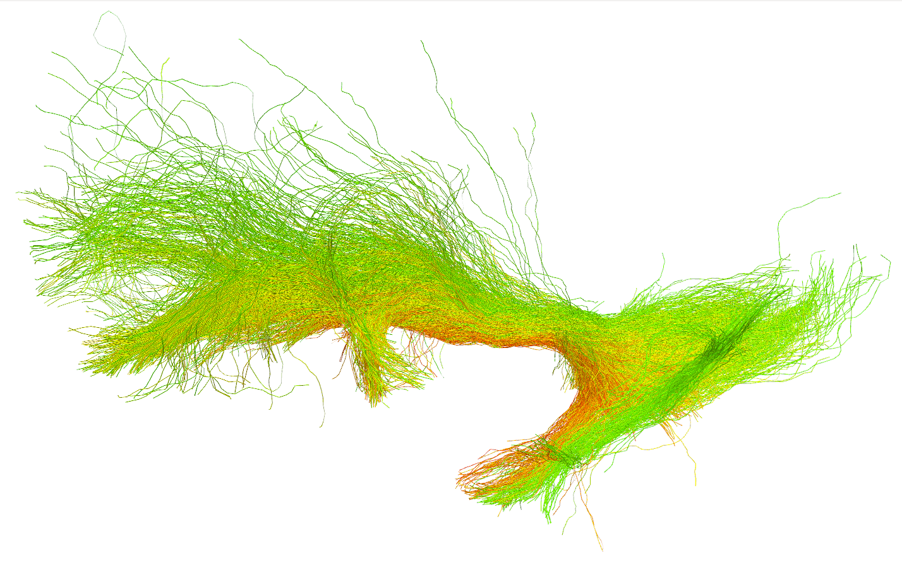
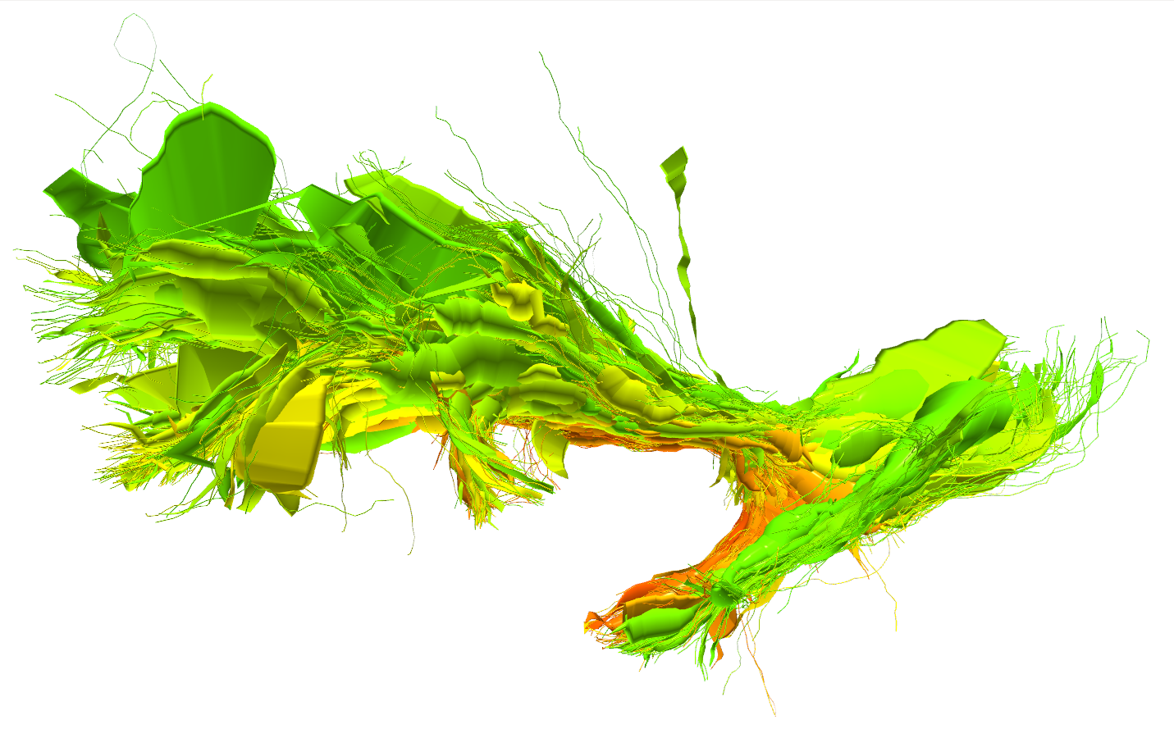
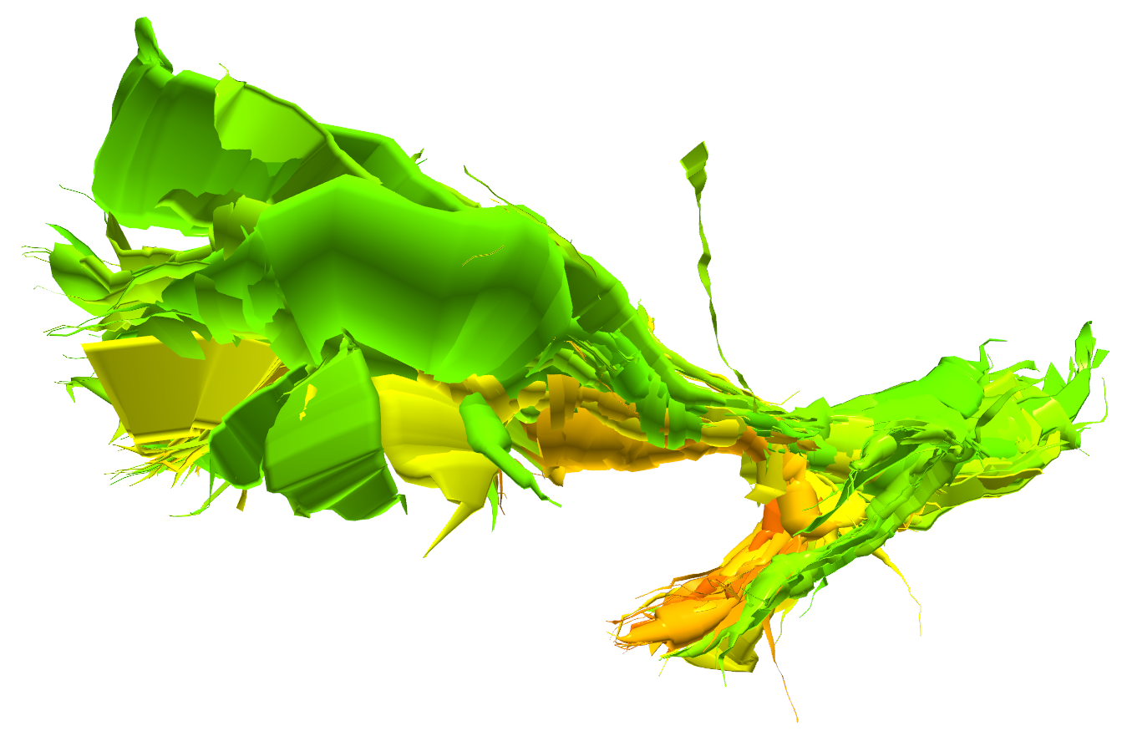
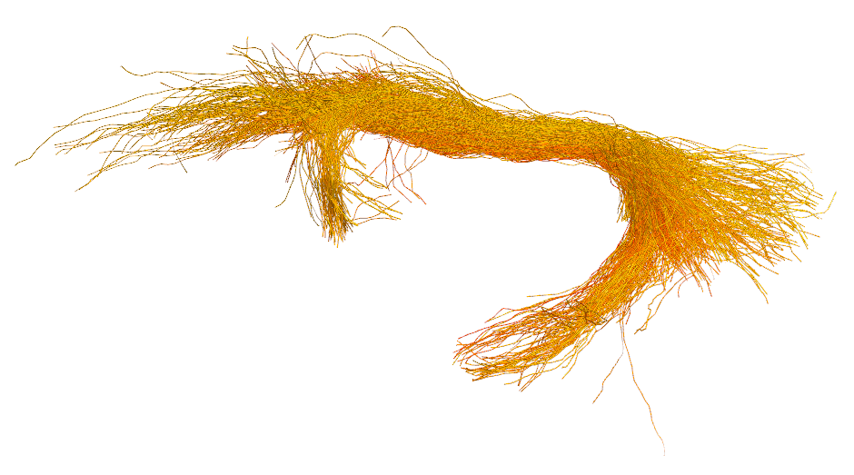
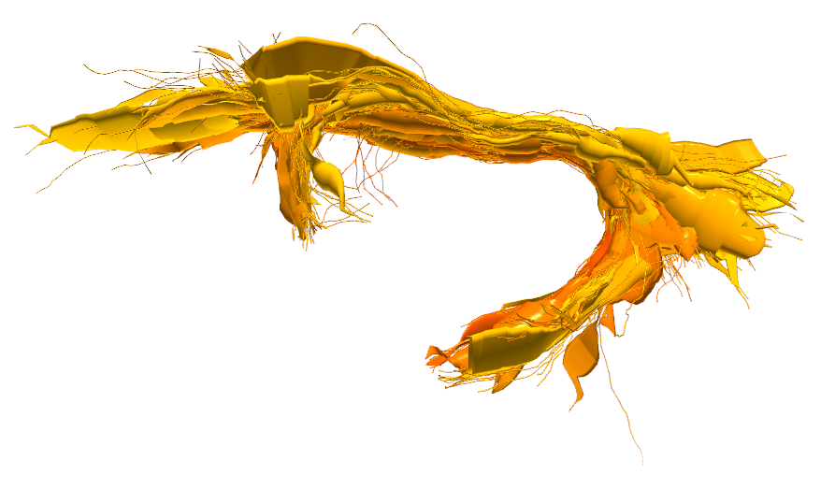
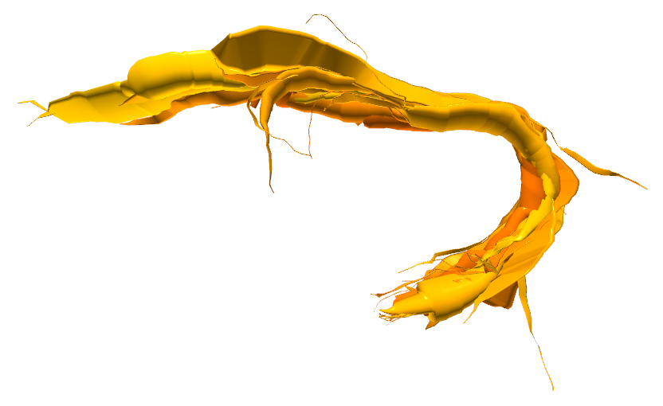





White Matter Multi-Resolution Segmentation Using Fuzzy Set Theory
*Alessandro Delmonte^{1,2}, *Corentin Mercier^{1,3}, Johan Pallud⁴, Isabelle Bloch^{1,2}, Pietro Gori¹
¹LTCI, Télécom ParisTech, Paris-Saclay University, Paris, France
²IMAG2 Laboratory, Imagine Institute, Paris, France
³LIX, Ecole Polytechnique, Palaiseau, France
⁴Neurosurgery Department, Sainte-Anne Hospital, Paris, France
* equally contributed to this work
INTRODUCTION / OBJECTIVE
We propose a method for white matter segmentation exploiting spatial relations between brain regions. We model the relations inherent incertitude relying on the spatial fuzzy set theory [1,2]. We complement this approach introducing an interactive visualization and segmentation technique for the bundle of interest based on a multi-resolution brain fiber representation [3].
SPATIAL RELATIONS MODELING
Qualitative anatomical definitions of white matter tracts are mostly based on spatial relations with respect to anatomical structures. We propose to model their intrinsic vagueness using fuzzy set theory [1, 2]. The degrees of uncertainty of all spatial definitions are combined together to a single anatomical coherence score (ACS), allowing for an interactive white matter segmentation.
Directional information, visualized as cones, are modeled using
as feature the minimum vision angle between each image point and the selected direction vector, with respect to the anatomical region they refer to.
ACS 1
ACS 2
ACS 3
IFOF
UF
MULTI-RESOLUTION REPRESENTATION
0
ACS
1
FIBERS
Original Bundle
CYLINDERS
Medium Resolution
CYLINDERS
Low Resolution
0.8
In order to ease understanding of the segmentation and give interactivity, we create a multi-resolution representation of the tractogram using [3]. This is performed by progressively merging fibers together according to their similarity measure.
We introduce a new term in this measures to take the ACS into account :
Formula (with WC ?)
Doing so, we make it feasible to navigate between thresholds in an interactive way, using the simplified geometry of the multi-resolution representation.
ACS 1
IFOF
ACS 2
0
ACS 1
1
UF
ACS 2
0
RESULTS
We validated our results on 5 unrelated healthy adults subjects from the HCP dataset.
Compared to WMQL [4] and manual segmentation, our technique presents less scattered fibers (dispersion), especially in the arc connecting the temporal and frontal lobe, as shown in the dispersion colormap of figure 5.
The interactive analysis allowed neurosurgeons to better identify ACS thresholds producing the results that best fit the clinical reality.
ACS thresholds were found to be reproducible among our different testings.
IEEE International Symposium on Biomedical Imaging – 2019 – Venice (IT)
FUTURE WORKS
Preparation of the anatomical definitions for other brain bundles.
Interactive segmentation, letting users select the anatomical definitions
References
[1] I. Bloch, “Fuzzy spatial relationships for image processing and interpretation: a review”, Image and Vision Computing, vol. 23, no. 2, pp. 89–110, 2005.
[2] A. Delmonte et al., “Segmentation of White Matter Tractograms Using Fuzzy Spatial Relations”, in Organization for Human Brain Mapping (OHBM), Singapore, 2018.
[3] C. Mercier et al., “Progressive and Efficient Multi-Resolution Representations for Brain Tractograms”, in EG VCBM, 2018.
[4] WMQL
alessandro.delmonte@institutimagine.org
corentin.mercier@telecom-paristech.fr
Poster n°582
Contacts:

